Slide 1

CHAPTER 4
ELEMENTARY NUMBER THEORY AND METHODS OF PROOF
Copyright © Cengage Learning. All rights reserved.

Slide 2

4.2
Direct Proof and Counterexample Ⅱ: Writing Advice
Copyright © Cengage Learning. All rights reserved.

Slide 3
Directions for Writing Proofs of Universal Statements

Slide 4
Directions for Writing Proofs of Universal Statements
Over the years, the following rules of style have become fairly standard for writing the final versions of proofs:
1. Copy the statement of the theorem to be proved on your paper.
This makes the theorem statement available for reference to anyone reading the proof.
2. Clearly mark the beginning of your proof with the word Proof.
This word separates general discussion about the theorem from its actual proof.

Slide 5
Directions for Writing Proofs of Universal Statements
3. Make your proof self-contained.
This means that you should explain the meaning of each variable used in your proof in the body of the proof. Thus you will begin proofs by introducing the initial variables and stating what kind of objects they are. The first sentence of your proof would be something like “Suppose m and n are any even integers” or “Let x be a real number such that x is greater than 2.” This is similar to declaring variables and their data types at the beginning of a computer program.

Slide 6
Directions for Writing Proofs of Universal Statements
At a later point in your proof, you may introduce a new variable to represent a quantity that is known at that point to exist. For example, if you have assumed that a particular integer n is even, then you know that n equals 2 times some integer, and you can give this integer a name so that you can work with it concretely later in the proof. Thus if you decide to call the integer, say, s, you would write, “Since n is even, n = 2s for some integer s,” or “since n is even, there exists an integer, say s, such that n = 2s.”

Slide 7
Directions for Writing Proofs of Universal Statements
4. Write your proof in complete, grammatically correct sentences.
This does not mean that you should avoid using symbols and shorthand abbreviations, just that you should incorporate them into sentences. For example, the proof of Theorem 4.1.1 contains the sentence
Then m + n = 2r + 2s by substitution
= 2(r + s) by factoring out 2.
To read such text as a sentence, read the first equals sign as “equals” and each subsequent equals sign as “which equals.”

Slide 8
Directions for Writing Proofs of Universal Statements
5. Keep your reader informed about the status of each statement in your proof.
Your reader should never be in doubt about whether something in your proof has been assumed or established or is still to be deduced. If something is assumed, preface it with a word like Suppose or Assume. If it is still to be shown, preface it with words like, We must show that or In other words, we must show that. This is especially important if you introduce a variable in rephrasing what you need to show.

Slide 9
Directions for Writing Proofs of Universal Statements
6. Give a reason for each assertion in your proof.
Each assertion in a proof should come directly from the hypothesis of the theorem, or follow from the definition of one of the terms in the theorem, or be a result obtained earlier in the proof, or be a mathematical result that has previously been established or is agreed to be assumed. Indicate the reason for each step of your proof using phrases such as by hypothesis, by definition of … by theorem … and so forth.

Slide 10
Directions for Writing Proofs of Universal Statements
7. Include the “little words and phrases” that make the logic of your arguments clear.
When writing a mathematical argument, especially a proof, indicate how each sentence is related to the previous one. Does it follow from the previous sentence or from a combination of the previous sentence and earlier ones? If so, start the sentence with the word Because or Since and state the reason why it follows, or write Then, or Thus, or So, or Hence, or Therefore, or Consequently, or It follows that, and include the reason at the end of the sentence.

Slide 11
Directions for Writing Proofs of Universal Statements
If a sentence expresses a new thought or fact that does not follow as an immediate consequence of the preceding statement but is needed for a later part of a proof, introduce it by writing Observe that, or Note that, or Recall that, or But, or Now. Sometimes in a proof it is desirable to define a new variable in terms of previous variables. In such a case, introduce the new variable with the word Let.

Slide 12
Directions for Writing Proofs of Universal Statements
8. Display equations and inequalities.
The convention is to display equations and inequalities on separate lines to increase readability, both for other people and for ourselves so that we can more easily check our work for accuracy.

Slide 13
Variations among Proofs

Slide 14
Variations among Proofs
It is rare that two proofs of a given statement, written by two different people, are identical. Even when the basic mathematical steps are the same, the two people may use different notation or may give differing amounts of explanation for their steps, or may choose different words to link the steps together into paragraph form.

Slide 15
Common Mistakes

Slide 16
Common Mistakes
The following are some of the most common mistakes people make when writing mathematical proofs.
1. Arguing from examples.
Looking at examples is one of the most helpful practices a problem solver can engage in and is encouraged by all good mathematics teachers. However, it is a mistake to think that a general statement can be proved by showing it to be true for some individual cases. A property referred to in a universal statement may be true in many instances without being true in general.

Slide 17
Common Mistakes
Consider the following “proof” that the sum of any two even integers is even.
This is true because if m = 14 and n = 6, which are both even, then m + n = 20, which is also even.
Some people find this kind of argument convincing because it does, after all, consist of evidence in support of a true conclusion. But remember that when we discussed valid arguments, we pointed out that an argument may be invalid and yet have a true conclusion.

Slide 18
Common Mistakes
In the same way, an argument from examples may be mistakenly used to “prove” a true statement. In the previous example, it is not sufficient to show that the conclusion “m + n is even” is true for m = 14 and n = 6. You must give an argument to show that the conclusion is true for any arbitrarily chosen even integers m and n.

Slide 19
Common Mistakes
2. Using the same letter to mean two different things.
Some beginning theorem provers give a new variable quantity the same letter name as a previously introduced variable. Consider the following “proof” fragment:
Suppose m and n are any odd integers. Then by definition of odd, m = 2k + 1 and n = 2k + 1 where k is an integer.
You might think of a variable in a mathematical proof as similar to a global variable in a computer program: once introduced, it has the same meaning throughout the program. In other words, its scope extends to the end of the program.

Slide 20
Common Mistakes
In this example, using the symbol k in the expressions for both m and n makes k a global variable. As a result, both m and n equal 2k + 1, and thus are equal to each other. The proof then only shows that a sum of two identical odd integers is even, not that the sum of two arbitrarily chosen odd integers is even.
3. Jumping to a conclusion.
To jump to a conclusion means to allege the truth of something without giving an adequate reason. Consider the following “proof” that the sum of any two even integers is even.

Slide 21
Common Mistakes
Suppose m and n are any even integers. By definition of even, m = 2r and n = 2s for some integers r and s. Then m + n = 2r + 2s. So m + n is even.
The problem with this “proof” is that to show an integer is even one needs to show that it equals twice some integer. This proof jumps to the conclusion that m + n is even without having found an integer that, when doubled, equals m + n.

Slide 22
Common Mistakes
4. Assuming what is to be proved.
To assume what is to be proved is a variation of jumping to a conclusion. As an example, consider the following “proof” of the fact that the product of any two odd integers is odd:
Suppose m and n are any odd integers. When any odd integers are multiplied, their product is odd. Hence mn is odd.

Slide 23
Common Mistakes
5. Confusion between what is known and what is still to be shown.
A more subtle way to jump to a conclusion occurs when the conclusion is restated using a variable. Here is an example in a “proof” that the product of any two odd integers is odd:
Suppose m and n are any odd integers. We must show that mn is odd. This means that there exists an integer s such that
mn = 2s + 1.

Slide 24
Common Mistakes
Also by definition of odd, there exist integers a and b such that
m = 2a + 1 and n = 2b + 1.
Then
mn = (2a + 1)(2b + 1) = 2s + 1.
So, since s is an integer, mn is odd by definition of odd.
In this example, when the author restated the conclusion to be shown (that mn is odd), the author wrote “there exists an integer s such that mn = 2s + 1.”

Slide 25
Common Mistakes
But we only know that the integer s exists if we know that mn is odd, which is what the author is trying to show. Thus, in the sentence starting with the word “Then,” the author jumped to an unjustified conclusion. This mistake might have been avoided if the author had written
“This means we must show that there exists an integer s such that mn = 2s + 1.”
An even better way to avoid this kind of error is not to introduce a variable into a proof unless it is either part of the hypothesis or deducible from it.

Slide 26
Common Mistakes
6. Use of any when the correct word is some.
There are a few situations in which the words any and some can be used interchangeably. For instance, in starting a proof that the square of any odd integer is odd, one could correctly write, “Suppose m is any odd integer” or “Suppose m is some odd integer.” In most situations, however, the words any and some are not interchangeable. Here is the start of a “proof” that the square of any odd integer is odd, which uses any when the correct word is some:

Slide 27
Common Mistakes
Suppose m is a particular but arbitrarily chosen odd integer. By definition of odd, m = 2a + 1 for any integer a.
In the second sentence it is incorrect to say that “m = 2a + 1 for any integer a” because a cannot be just “any” integer; in fact, solving m = 2a + 1 for a shows that the only possible value for a is (m − 1) ∕ 2. The correct way to finish the second sentence is, “m = 2a + 1 for some integer a” or “there exists an integer a such that m = 2a + 1.”

Slide 28
Common Mistakes
7. Misuse of the word if.
Another common error is not serious in itself, but it reflects imprecise thinking that sometimes leads to problems later in a proof. This error involves using the word if when the word because is really meant. Consider the following proof fragment:
Suppose p is a prime number. If p is prime, then p cannot be written as a product of two smaller positive integers

Slide 29
Common Mistakes
The use of the word if in the second sentence is inappropriate. It suggests that the primeness of p is in doubt. But p is known to be prime by the first sentence. It cannot be written as a product of two smaller positive integers because it is prime. Here is a correct version of the fragment:
Suppose p is a prime number. Because p is prime, p cannot be written as a product of two smaller positive integers.

Slide 30
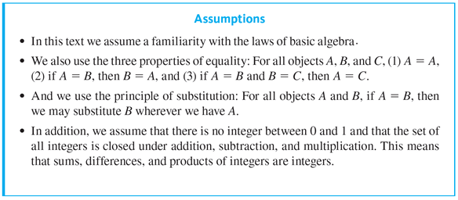
Example 4.2.1 – An Odd Integer Minus an Even Integer
Prove that the difference of any odd integer and any even integer is odd. Use only the definitions of odd and even and the Assumptions listed below, not any other properties of odd and even integers.

Slide 31
Example 4.2.1 – An Odd Integer Minus an Even Integer
continued
Follow the directions given in this section for writing proofs of universal statements

Slide 32
Example 4.2.1 – Solution
You may already have a sense that the statement to be proved is true, but to make sure your intuition is correct and to develop a careful proof, rewrite the statement using names such as a and b for the odd and even integers so that you will have a convenient way to refer to them:
For all integers a and b, if a is odd and b is even, then a − b is odd.
Or: For every odd integer a and every even integer b, the difference a − b is odd.
Or: If a is any odd integer and b is any even integer, then a − b is odd.

Slide 33
Example 4.2.1 – Solution
continued
Thus the starting point for your proof would be something like, “Suppose a is any odd integer and b is any even integer,” and the conclusion to be shown would be “We must show that a − b is odd.”
If, in addition, you know how to use the definitions of odd and even, you will have reduced the creative part of developing the proof to a small, but crucial, section in the middle.

Slide 34
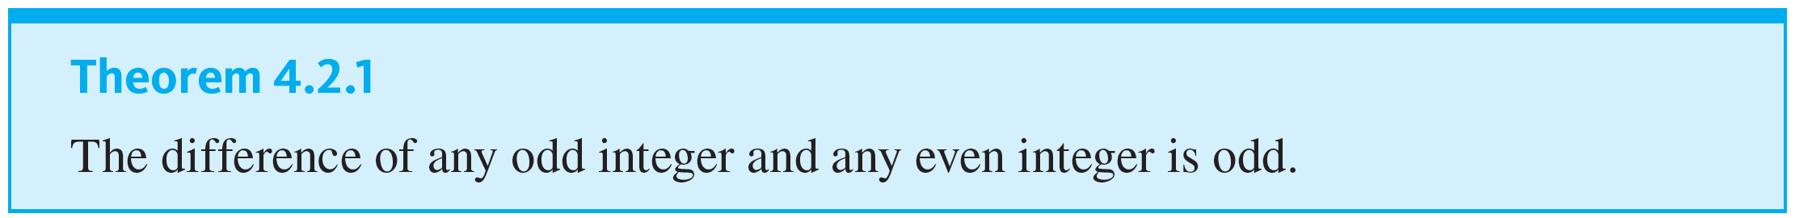
Common Mistakes

Slide 35


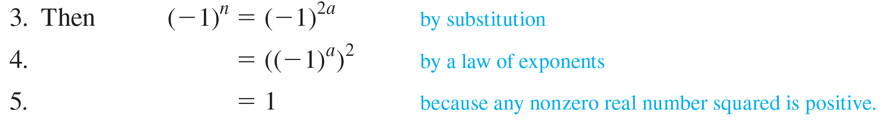
Example 4.2.2 – Identifying a Mistake in a Proposed Proof
Find the mistake in the following “proof.”
Theorem: If n is any even integer, then
Proof:
1. Suppose n is any even integer. [We must show that
is even.]
2. By definition of even, n = 2a for some integer a.

Slide 36

Example 4.2.2 – Solution
This “proof” incorrectly jumps to a conclusion in line 5. Although it is true that the square of any nonzero real number is positive, it does not follow that the square of
Exercise 10 at the end of this section asks you to give a correct proof of this theorem.

Slide 37
Showing That an Existential Statement Is False

Slide 38
Showing That an Existential Statement Is False
We know that the negation of an existential statement is universal. It follows that to prove an existential statement is false, you must prove a universal statement (its negation) is true.

Slide 39

Example 4.2.3 – Disproving an Existential Statement
Show that the following statement is false:
There is a positive integer n such that
is prime.

Slide 40
Example 4.2.3 – Solution
Proving that the given statement is false is equivalent to proving its negation is true. The negation is
For all positive integers n,
is not prime.
Because the negation is universal, it is proved by generalizing from the generic particular.
Claim: The statement “There is a positive integer n such that
is prime” is false.

Slide 41

Example 4.2.3 – Solution
continued
Proof:
Suppose n is any [particular but arbitrarily chosen] positive integer. [We will show that
Factoring shows that
In addition, n + 1 and n + 2 are integers (because they are sums of integers), and both n + 1 > 1 and n + 2 > 1 (because n ≥ 1). Thus
is a product of two integers each greater than 1, and so
is not prime.

